Slide 1










2026
Kurtz Bros, Inc.
EMPLOYEE BENEFITS GUIDE

Slide 2
TABLE OF CONTENTS
ENROLLMENT
What’s NEW for 2026 | 3
Benefits Designed to Support You | 4
Enrollment | 5
MEDICAL
Medical Summaries | 7
Samaritan Fund Program | 8
KISx Card | 9
Preventive Care | 11
TrueRx | 12
SHARx Specialty Prescription Program | 13
Rx ‘N Go | 14
Kaia Health – Virtual Physical Therapy | 15
HealthJoy | 16
Health Savings Account | 17
Flexible Spending Accounts | 18
DENTAL | 19
VISION | 20
EMPLOYEE ASSISTANCE PROGRAM | 21
LIFE INSURANCE
Basic Life and AD&D Insurance | 22
Supplemental Life and AD&D Insurance | 23
DISABILITY INSURANCE | 24
SUPPLEMENTAL INSURANCE PLANS | 25
401(k) RETIREMENT PLAN | 26
BENEFITS CONTACT INFORMATION | 27
ENROLLMENT | 2

Slide 3



WHAT’S NEW FOR 2026!
Samaritan Fund Program – A program that exists to eliminate financial burden associated with medical costs for care following a serious medical diagnosis. See page 8 for more information.
True Rx – A patient-first pharmacy benefit manager that pays attention and helps keep medications affordable and effective. See page 12 for more information.
  “Because we are family-owned by generational pharmacists, clinical excellence and patient care runs deep in our DNA.” – Mark Williams, RPh: Founder and CEO
SHARx – A pharmacy advocacy program that works to get high-cost medications of $350 or higher FREE or at highly reduced cost for members. See page 13 for more information.
HealthJoy - A “one-stop-shop” always at your fingertips with an app that allows you to easily find, understand, use your benefits, and so much more! See page 16 for more information.
Look for the at the top of the page!
ENROLLMENT | 3

Slide 4


BENEFITS DESIGNED TO SUPPORT YOU
At Kurtz Bros, we know our dedicated employees—YOU—are key to our overall success. Offering a comprehensive benefits package is an important part of your overall compensation. Each year we review our benefits package to ensure that we are providing you and your family with quality plan options at an affordable cost.
This Benefits Guide is designed to help you:
Better understand the benefits we offer so that you can choose the plans that are right for you and your family.
Know what to expect when you use your benefits (i.e., what your plan covers, how much you will pay, etc.).
Please take the time to carefully review your plan options and be sure to share this guide with your family members if they are or will be covered by any of the plans.
ELIGIBILITY
You are eligible to enroll in the Kurtz Bros benefits if you are a full-time employee working at least 30 hours per week. Your benefits are effective the first day of the month following 60 days of employment.
Covering Your Family Members
Many of the plans offer coverage for your eligible family members, including:
Your spouse.
Your children to age 26, regardless of student, marital, or tax-dependent status (including a stepchild, legally-adopted child, a child placed with you for adoption, or a child for whom you are the legal guardian).
Your dependent children of any age who are physically or mentally unable to care for themselves.
Your benefits begin the first day of the month following 60 days of employment.
ENROLLMENT | 4

Slide 5

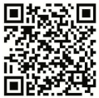
ENROLLING AND MAKING CHANGES
When to Sign Up for Benefits
New Employees
As a new employee, you must enroll in benefits within 30 days of your date of hire. If you do not enroll within 30 days, you will need to wait until the next open enrollment period to enroll.
Current Employees
Open enrollment is the only time during the year that you can change your benefits unless you experience a qualifying life event. During the open enrollment period, you can newly-enroll in coverage or make changes to your current elections.
If you wish to contribute pre-tax dollars to a flexible spending account in 2026, you must make a new election during open enrollment. FSA elections do not carry over from year to year.
At Kurtz Bros, open enrollment will be held in November. Any changes you make during open enrollment become effective January 1.
Enroll Online
Benefits enrollment is completed online through ADP Workforce Now at workforcenow.adp.com or in the ADP Mobile Solutions app. Elections must be completed through ADP, or you will not have coverage for the 2026 plan year unless you have a qualifying life event.
            Scan the QR code for the ADP Mobile app:
To complete your enrollment, you will need:
Dates of birth and social security numbers for yourself as well as any family members you are enrolling.
Proof of eligibility for your spouse and dependent children (e.g., marriage license, birth certificate).
Changing Your Benefits During the Year
As stated above, you cannot change your benefits during the year unless you experience a qualifying life event. The most common qualifying life events are:
Marriage, legal separation, or divorce.
Birth of a child (including adoption).
Loss of other coverage (e.g., child turns 26 and loses coverage through parent’s plan).
There are other, less common life events that allow you to change your benefits. Please contact Human Resources for a complete list of qualifying life events.
To request a benefits change, notify human resources within 30 days of the qualifying life event. Change requests submitted after 30 days cannot be accepted. Please note: You may need to provide proof of the event, such as a marriage certificate or record of birth.
ENROLLMENT | 5

Slide 6


MEDICAL
Kurtz Bros offers four medical insurance plans through UMR. Please take the time to understand the features and differences of each plan so that you choose the coverage that is best for you and your family.
Choosing a Medical Plan
As you review your plan options, it may be helpful to consider the following questions:
  What is the cost to enroll in the plan? This is the amount you pay out of your paycheck.
  How much will you pay out of your pocket when you see your doctor or need other health care services?
  Do you prefer to pay more out of your paycheck each week, but less when you need health care? Or do you prefer to pay less out of your paycheck each week, but more when you need health care?
  Who are you covering, and what are their current medical needs, including prescription drugs taken regularly?
  What is the cost to enroll?
  How much will I pay?
  Who am I covering?
MEDICAL | 6

Slide 7

MEDICAL
You will pay less out of your pocket when you choose a UMR network provider. Locate a UMR network provider at www.umr.com.
The table below summarizes the key features of the medical plans. The coinsurance amounts listed reflect the amount you pay for services. Please refer to the official plan documents for additional information on coverage and exclusions.
Summary of Covered Benefits | PPO 1500 | PPO 2500 | PPO 5000 | HDHP 3300
 | IN- NETWORK | IN- NETWORK | IN- NETWORK | IN- NETWORK
Deductible (Individual/Family) | $1,500/ $3,000 | $2,500/ $5,000 | $5,000/ $10,000 | $3,400/ $6,000
Coinsurance (You Pay) | 20% | 30% | 20% | 0%
Out-of-Pocket Max (Individual/Family) | $3,000/ $6,000 | $5,000/ $10,000 | $7,500/ $12,500 | $8,500/ $17,000
Preventive Care | 100% Covered | 100% Covered | 100% Covered | 100% Covered
Physician Services
Primary Care Physician (Adults/Children up to age 19) | $15/$0 Copay | $15/$0 Copay | $15/$0 Copay | 0% after Ded.
Specialist | $50/$100 Copay | $50/$100 Copay | $50/$100 Copay | 0% after Ded.
Telemedicine | 100% Covered | 100% Covered | 100% Covered | 100% Covered
Urgent Care | $15 Copay | $25 Copay | $25 Copay | 0% after Ded.
Lab/X-Ray
Diagnostic Lab/X-Ray | 20% after Ded. | 30% after Ded. | 20% after Ded. | 0% after Ded.
High-Tech Services (MRI, CT, PET) | 20% after Ded. | 30% after Ded. | 20% after Ded. | 0% after Ded.
Hospital Services
Inpatient | 20% after Ded. | 30% after Ded. | 20% after Ded. | 0% after Ded.
Outpatient | 20% after Ded. | 30% after Ded. | 20% after Ded. | 0% after Ded.
Emergency Room | $300 Copay | $300 Copay | $300 Copay | 0% after Ded.
Prescription Drugs
Generic | $10 Copay | $10 Copay | $10 Copay | $10 Copay after Ded.
Preferred Brand | $35 Copay | $35 Copay | $35 Copay | $35 Copay after Ded.
Non-Preferred Brand | $70 Copay | $70 Copay | $70 Copay | $70 Copay after Ded.
Mail Order (Up to a 90-Day Supply) | $25/$87.50/$175 Copay | $25/$87.50/$175 Copay | $25/$87.50/$175 Copay | $25/$87.50/$175 Copay after Ded.
MEDICAL | 7

Slide 8


SAMARITAN FUND PROGRAM
SAMARATIN FUND | 8

Slide 9


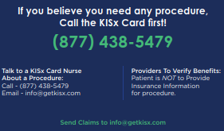
KISx CARD WITH VALENZ HEALTH
Surgery simplified. The KISx Card, or Keep It Simple Surgery, is a surgical and imaging program that is available to members enrolled in any one of the UMR medical plans at no additional cost.
The KISx Card covers over 400 different procedures, including:
  Orthopedic surgery
  General Surgery
  Colonoscopies
  MRI, CT, and PET scans
If you believe you need any procedure, call the KISx Card first!
Step 1: Call, Text, or Email a KISx Card Nurse at 877.438.5479 or info@getkisx.com to find out more about your procedure and how the program works. They will assist you in finding the right facility close to home.
Step 2: Your KISx Card Nurse will help you schedule your procedure. Upon scheduling, they will provide you with a voucher to take to your initial consultation.
Step 3: Save! You will not pay anything out of pocket when you choose a KISx Card provider. Your entire procedure is covered through the KISx Card.
By choosing a KISx Card provider, you will always pay $0 out of your pocket!
KISx CARD | 9

Slide 10

WHERE TO GO WHEN YOU NEED CARE
Know where to go for your health care.
Where you go for medical services can make a big difference in how much you pay and how long you wait to see a health care provider. Use the chart below to help you choose where to go for care. Locate a UMR doctor or facility at www.umr.com.
Medical Services | Cost | Wait Time | Appropriate For
Emergency Room | Highest $$$ | Longest | Serious, life-threatening conditions and issues requiring immediate attention
Urgent Care | Medium $$ | Moderate | Non-life-threatening but urgent situations
Telemedicine | Lower $ | Shortest | Non-emergency conditions like allergies, flu, rash, or pink eye
Doctor’s Office/PCP | Variable $ | Appointment based | Preventive care, routine check-ups, managing chronic conditions
Save money and time by choosing the right place to go for your health care.
PREVENTIVE CARE | 10

Slide 11

PREVENTIVE CARE
The UMR medical plans pay 100% of the cost of preventive care when it is provided by a network provider. Preventive care helps detect or prevent serious diseases and medical problems before they can become major.
Examples of preventive health services:
Annual check-up
Flu shot
Mammogram
Colonoscopy
Vaccinations
Top 5 reasons to prioritize preventive care:
Early detection: Preventive care allows for the early detection of health issues before they become serious. Regular screenings can identify diseases like cancer, diabetes, and heart disease in their early stages when they are more manageable, and treatment outcomes are often more successful.
Better health outcomes: With routine preventive care, you are likely to experience better overall health outcomes. Regular check-ups can help maintain good health and prevent the onset of chronic diseases.
Cost savings: Preventive care can save you money in the long run. By catching health issues early, you can avoid the high costs associated with treating advanced diseases. It's often less expensive to prevent a disease than to treat it.
Improved quality of life: Regular preventive care can contribute to an improved quality of life. By maintaining good health and preventing disease, you can enjoy life more fully with less interruption due to illness.
Increased lifespan: Preventive care can lead to a longer, healthier life. By focusing on prevention, you can reduce the risk of premature death from preventable diseases.
Staying up to date on preventive care can save you money and help keep you feeling your best.
PREVENTIVE CARE | 11

Slide 12

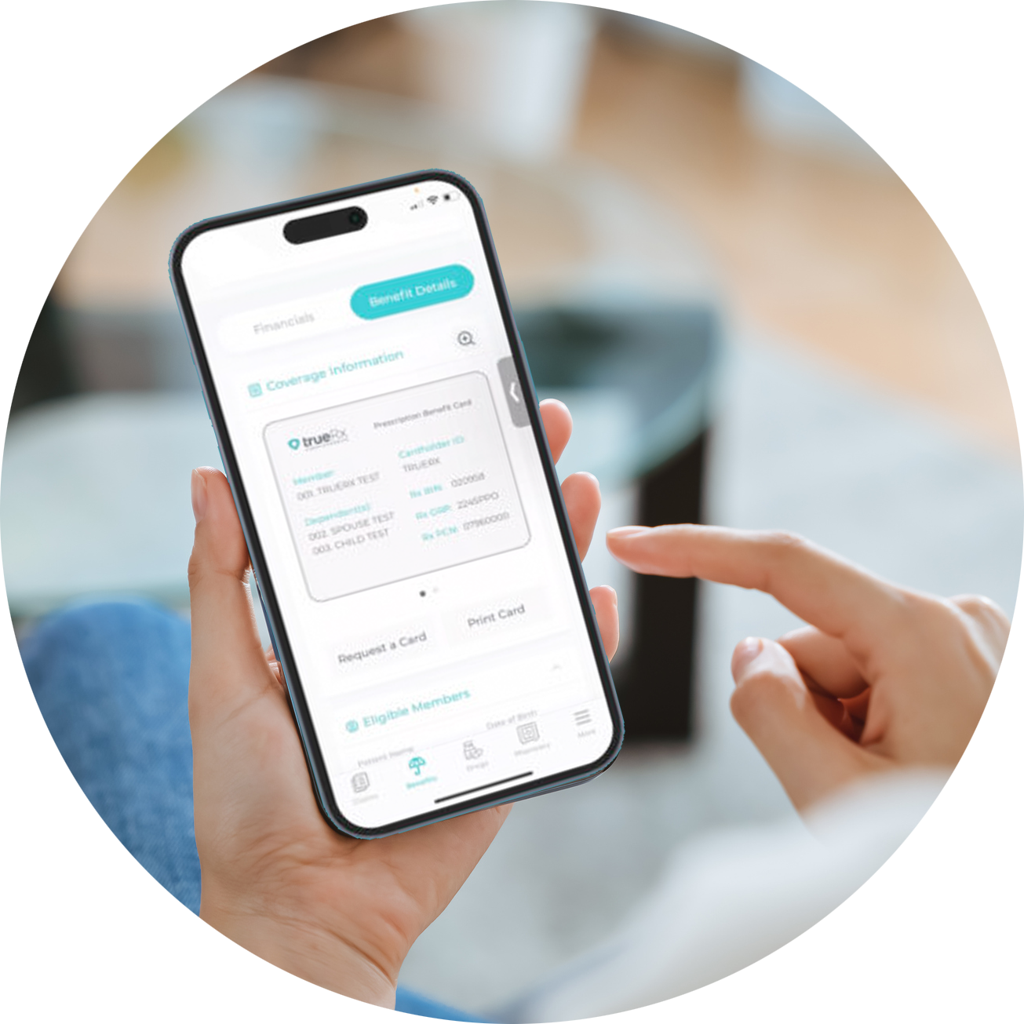
TRUE Rx
Welcome to a pharmacy benefits experience that puts you first!
If you enroll in medical coverage, you may save money on your medications when you use the True Rx pharmacy.
To learn how your medication will be covered, visit the True Rx website and click on Formularies under the member heading.
A prescription drug formulary is a list that shows what tier level a medication will be covered under by the medical plan.
  Once you know the tier level of your medication, refer to the Benefits Guide for cost information.
Getting started is easy!
Sign into the member portal.
Whether you are new to True Rx, or a long-time member, please visit the member portal and click on the "register now" button on the bottom right.
Download the latest version of the mobile app. Search "MyRxPlan" in the App Store or Google Play.
For mail order delivery, contact WB Rx Express at wbrxexpress.com/mail-order or call 833-391-0126.
Bring your insurance card to the pharmacy. Your pharmacist will need important information on your card to process prescriptions.
  Please be aware that the medical plans do not cover Tier 4 specialty drugs. However, Kurtz Bros provides the SHARx advocacy program, which can help you save money on your high-cost specialty medications. See page 13 for more information about this program.
TRUE RX | 12

Slide 13

SHARx SPECIALTY PRESCRIPTION PROGRAM
Attack prescription costs!
SHARx is a pharmacy advocacy program that works to save you money on your specialty prescription medications costing $350 or more that are not covered by medical insurance. Kurtz Bros provides this program to all medical plan members at no additional cost.
Members often get their medications for FREE! For medications that are not available at no cost, SHARx helps members access these medications through the SHARx interactive portal at a very small fraction of the cost.
Getting started is easy!
Create an account.
Verify personal and prescription information.
Sign HIPAA form.
Visit the SHARx website at www.sharxplan.com or call 314-451-3555
SHARX | 13

Slide 14

RX ‘N GO
What is Rx ‘N Go?
Rx ‘N Go is an optional mail-order pharmacy program for generic & insulin medications. These medications are $0 copay and $0 delivery cost! There are approximately 1,300 generic maintenance & insulin medications through Rx ‘N Go. Medications are 100% paid for by your employer and mailed to you at no cost! By using Rx ‘N Go, you can receive up to a 90-day supply of certain medications that treat conditions such as cholesterol, diabetes, hypertension, emotional health, asthma and more, as written by your doctor.
To check if you medication is available through Rx ‘N Go, follow the steps below:
  Go to www.rxngo.com and select the Medications tab
  Select your Employer & Plan, or
  Search by Medication Name – if your medication is listed, it will be free!
How it works
Rx ‘N Go is separate from your medical insurance. If you would like to take advantage of the program, you MUST sign up directly with Rx ‘N Go. To get registered, follow the instructions below:
Check Medication Availability: Search Medications to see if your generic or insulin Rx is covered under your employer’s plan or call 888-697-9646.
Register in Minutes: Set up your account with ease. We just need your full name, DOB, shipping address, phone number and your employer's name. We do not ask for any insurance or credit card information. You can Register Online or by calling 888-697-9646.
Submit Your Prescription with Auto-Refills: The friendly Rx ‘N Go customer service team makes the process quick and easy! Already have an existing prescription? Our pharmacy, Transition Pharmacy, can work with your pharmacy to transfer it to Rx ‘N Go.
Have your doctor submit the prescription via:
Mail your prescriptions to the following address:
Rx ‘N Go c/o Transition Pharmacy
2546 Metropolitan Dr.
Trevose, PA 19053
Questions? Contact Customer Support at
rxngo@transitionrx.com or 888-697-6946
Phone
888-697-9646
Fax
888-697-0646
Escribe
Transition Pharmacy (PA)
NPI # 1336325265
RX ‘N GO | 14

Slide 15
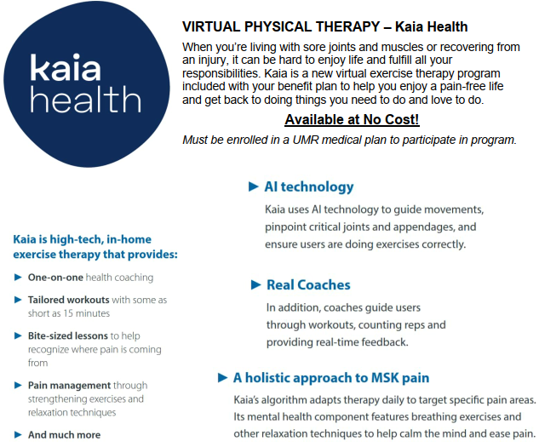

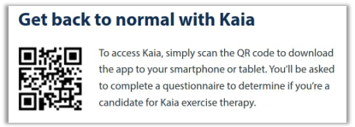
KAIA HEALTH – VIRTUAL PHYSICAL THERAPY
KAIA HEALTH | 15

Slide 16
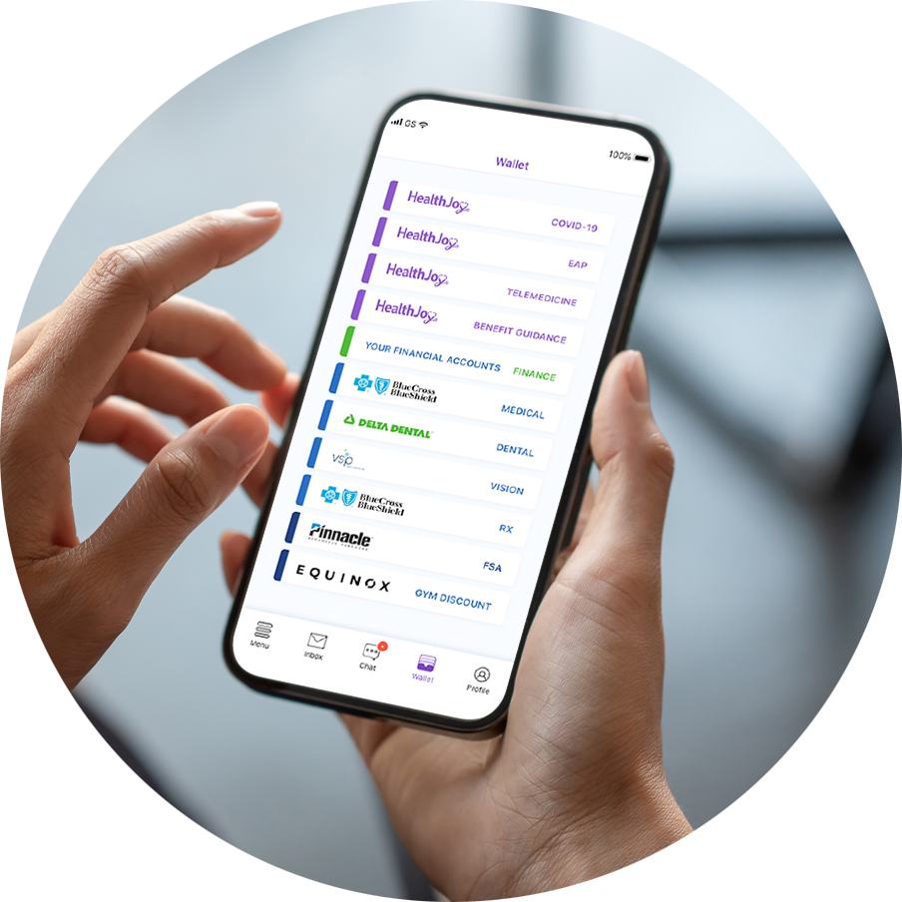

HEALTHJOY
HealthJoy is an app that allows you to easily find, understand, and use your benefits.
With HealthJoy, you can:
View all your benefits in one place—Access digital versions of your benefits cards in your HealthJoy wallet.
Find care—Search for in-network doctors, facilities, and pharmacies. Ready for your next appointment or have any questions? The concierge team can schedule an appointment on your behalf!
Get answers—The concierge team is here to answer any of your benefits questions and can provide personalized health recommendations, guiding you to the right benefits at the right moment.
Find savings on your medications—The HealthJoy team can review your medications list and identify lower-cost alternatives.
Connect with a medical professional any time, anywhere—24/7/365.
Medical bill review—The HealthJoy team can explain your bill and even negotiate with providers to save you money. Email your bill to groups@healthjoy.com.
Healthcare, simplified!
Make HealthJoy your first stop for all your healthcare and employee benefits needs.
No Smartphone? No Worries!
Call or email HealthJoy to get the same services!
P 877.500.3212
E groups@healthjoy.com.
Download in the App Store and Google Play now!
HEALTHJOY | 16

Slide 17

HEALTH SAVINGS ACCOUNT
If you enroll in the UMR high-deductible health plan (HDHP), you may be eligible to open and fund a health savings account (HSA) through the bank of your choice.
2026 IRS HSA contribution limits
Contributions to an HSA cannot exceed the IRS allowed annual maximums.
Employee-only: $4,400.
All other coverage levels: $8,750.
If you are age 55+ by December 31, 2026, you may contribute an additional $1,000.
HSA eligibility
You are eligible to fund an HSA if you are enrolled in the Carrier Name HDHP and meet additional eligibility requirements.
Refer to your bank's website for eligibility details.
Maximize your savings!
Money you put into your HSA is not taxed.
Tax-free spending when HSA funds are used to pay for eligible health care expenses.
HSA contributions grow tax free, which means you don’t pay taxes on the interest or investment earnings.
HSA funds roll over from year to use (no use it or lose it policy).
The money you put into your HSA is yours to keep—even if you change plans or jobs in the future.
After you reach age 65, your HSA dollars can be spent without penalty on any expense.
An HSA is a savings account that you can use to pay out-of-pocket health care expenses with pre-tax dollars.
HEALTH SAVINGS ACCOUNT | 17

Slide 18

FLEXIBLE SPENDING ACCOUNTS
Kurtz Bros offers two flexible spending account (FSA) options through Ameriflex. The money you put into an FSA is deducted from your paycheck before taxes are taken out, meaning you pay less in taxes because your taxable income is lower.
Plan carefully!
Any funds left in the account after the plan year grace period will be forfeited. Thus, while an FSA can save you money on taxes and health care and dependent care costs, it's important to not contribute more than you think you'll spend on eligible expenses in a single year.
Health care flexible spending account (HCFSA)
Pay for eligible out-of-pocket medical, dental, and vision expenses with pre-tax dollars.
Over-the-counter (OTC) medications are not eligible for reimbursement without a prescription.
Total amount for the year is available on January 1, 2026.
The health care FSA maximum contribution is $3,400 for the 2026 calendar year.
Dependent care flexible spending account (DCFSA)
Pay for eligible dependent day care expenses with pre-tax dollars.
Eligible dependents are children under 13 years of age, or a child over 13, spouse, or elderly parent residing in your house who is physically or mentally unable to care for himself or herself.
Funds are deposited into your account on a per-pay-period basis.
You may contribute up to $7,500 to the dependent care FSA for the 2026 plan year if you are married and file a joint return or if you file a single or head of household return. If you are married and file separate returns, you can each elect $3,750 for the 2026 plan year.
Log into your account at www.myameriflex.com to:
View your account balance(s)
Calculate tax savings
View eligible expenses
Submit claims
Download forms
View transaction history
And more!
Paying with an FSA is like using a 20%* off coupon for your health care and dependent care expenses.
*Actual savings varies based on tax bracket.
FLEXIBLE SPENDING ACCOUNT | 18

Slide 19


DENTAL
Kurtz Bros offers dental insurance through Guardian. This plan includes in- and out-of-network benefits, which means you can choose any dentist that you would like. However, you will pay less out of your pocket when you choose a network dentist. Locate a Guardian network dentist at www.guardianlife.com.
The table below summarizes the key features of the dental plan. The coinsurance amounts listed reflect the amount you pay for services. Please refer to the official plan documents for additional information on coverage and exclusions.
Type of Service | In Network | Out of Network
Calendar Year Deductible Single Family | $50 $150 | $50 $150
Annual Dental Maximum per Person | $1,500 | $1,000
Preventive Services Oral exams, cleanings, x-rays | 100% | 100%
Basic Services Fillings, gum treatment, root canals | 100% | 80%
Major Services Crowns, bridges, dentures | 60% | 50%
Orthodontia Children to Age 19 Lifetime Max per Individual | 60% $1,000 | 60% $1,000
Bi-weekly Dental Payroll Deductions
Employee | $5.00
Employee + family | $15.00
DENTAL+RATES | 19

Slide 20



VISION
Kurtz Bros offers vision insurance through Guardian using the VSP or Davis Vision networks. This plan allows you to choose any eye care provider. However, you will maximize the plan benefits when you choose a network provider. Locate a VSP or Davis Vision network provider at www.vsp.com or www.davisvision.com.
The table below summarizes the key features of the vision plan. Please refer to the official plan documents for additional information on coverage and exclusions.
In-Network Vision Benefits |  | VSP | Davis Vision
Well Vision Exam | One every calendar year (two per year for dependent children*) | $10 | $10
Frame | Allowance + 20% off amount over your allowance One every other calendar year (one per year for dependent children*) | $25 ($130 allowance) | $25 ($120 allowance)
Lenses | Single vision, lined bifocal, and lined trifocal lenses Polycarbonate lenses One every calendar year (more frequent lenses for children may be covered in full if prescription changes*) | Included | Included
Contacts | Contact lens exam (fitting and evaluation) Allowance for contacts (no copay) One every calendar year (in lieu of glasses) | $130 allowance | $120 allowance
*Dependent children are covered to the end of the month in which they turn age 26.
Bi-Weekly Vision Payroll Deductions |  | VSP Network Plan | Davis Vision Plan
Employee | $3.08 |  | $2.00
Employee + family | $7.49 |  | $4.85
VISION+RATES | 20

Slide 21





EMPLOYEE ASSISTANCE PROGRAM
Kurtz Bros provides you and your household family members with an employee assistance program (EAP) through Optum Live and Work Well at no cost to you. The EAP is a valuable resource that can help you identify and resolve many workplace, family, social, economic, and mental health issues.
This is a confidential program available 24 hours a day, 7 days a week, to help you and your family members handle the stresses involved with everyday issues and/or crisis situations.
Services are accessible through toll-free phone calls and online access
Each member can receive up to 3 free face-to-face counseling sessions, per incident, per year
No personal information is ever shared with Kurtz Bros
Ways to access:
Call toll free 24/7: 877-660-3806
Visit www.liveandworkwell.com
Sign in using your HealthSafe ID to securely access your personal benefit information
Enter anonymously using access code: FP3EAP
The free EAP can support you.
Call 24/7 at 1-877-660-3806
or visit www.liveandworkwell.com
EMPLOYEE ASSISTANCE PROGRAM | 21

Slide 22


LIFE INSURANCE
Life and accidental death and dismemberment (AD&D) insurance provides financial protection for those who depend on you for financial support.
Basic Life and AD&D Insurance
Kurtz Bros provides you with basic life and AD&D insurance through UnitedHealthcare at no cost to you.
Employee life insurance benefit: amount is determined by your Employee Class, please see HR with any questions
Employee AD&D insurance benefit: included with your life benefit amount
If you are eligible for $50,000 or more in basic, Kurtz Bros-paid life insurance, you are required to pay income tax on the value of the coverage in excess of $50,000.
Is your beneficiary info up-to-date? It can be updated at any time throughout the year.
LIFE INSURANCE+RATES | 22

Slide 23
LIFE INSURANCE
Life and accidental death and dismemberment (AD&D) insurance provides financial protection for those who depend on you for financial support.
Supplemental Life and AD&D Insurance
Depending on your personal situation, basic life and AD&D insurance might not be enough coverage for your needs. Kurtz Bros provides you the option to purchase additional life and AD&D insurance at group rates through UnitedHealthcare. You may also purchase coverage for your spouse and eligible children. You must purchase additional coverage for yourself in order to purchase coverage for your spouse and/or child(ren).
Use the calculator at www.uhc.com to determine how much coverage you need.
Coverage options:
Employee: $25,000 increments up to $150,000 or 5x annual salary, whichever is less; guarantee issue: $150,000.
Spouse: $5,000 increments up to 100% of the employee coverage amount; guarantee issue: $50,000.
Dependent children: Birth to 14 days: $500; 14 days to age 19 (or 26 if a full-time student): $10,000; not to exceed 50% of employee amount ; guarantee issue: $10,000.
Supplemental life rates are based on age. Benefits will reduce to 35% at age 65, 60% at age 70, 75% at age 75, and 85% at age 80.
If you purchase life and AD&D insurance when you are first eligible to enroll, you may purchase up to the guarantee issue amounts without completing a statement of health (evidence of insurability).
If you do not enroll when first eligible and choose to enroll during a future open enrollment period, you will be required to submit evidence of insurability for any amount of coverage. Coverage will not take effect until approved by UnitedHealthcare.
LIFE INSURANCE+RATES | 23

Slide 24

DISABILITY INSURANCE
Disability insurance can help you meet your financial needs if you become unable to work due to an illness or injury.
Short-Term Disability Insurance—PAID BY KURTZ BROS
Kurtz Bros provides short-term disability (STD) insurance through UnitedHealthcare to all full-time employees at no cost to you. Benefits will be reduced by other income, including state-mandated STD plans. Benefit: weekly maximum amount is based on Employee Class, please see HR with any questions Elimination period: 0 days accident / 7 days illness Benefit duration: Up to 13 weeks
Long-Term Disability Insurance—Plan Features
Kurtz Bros provides the opportunity to purchase long-term disability (LTD) insurance through UnitedHealthcare to all full-time employees. LTD insurance is designed to help you meet your financial needs if your disability extend beyond the STD period. Benefit: 60% of base monthly pay up to $7,500 Elimination period: 90 days. Benefit duration: Social security normal retirement age.
Helps provide financial stability if you become unable to work due to injury or illness.
DISABILITY INSURANCE | 24

Slide 25
SUPPLEMENTAL INSURANCE PLANS
You have the option to enroll in critical illness, accident, and hospital insurance through UnitedHealthcare. These plans provide financial protection to you and your family members in cases of unexpected illness or injury—and can fill in gaps not covered by health insurance. You may purchase coverage for yourself, your spouse, and your dependent children under the age of 26.
All three plans pay cash benefits that can be used for any expenses, including copays and deductibles, mortgage payments, groceries, utility bills, and day care. The money is yours to use—however you would like.
Critical Illness Insurance
Pays you a cash benefit if you or a covered family member are diagnosed with a specific critical illnesses. Examples of a critical illness: heart attack, coronary artery disease, stroke, major organ failure, and cancer. This policy has off the job coverage and includes a $50 Wellness Benefit if you receive an eligible screening.
Accident Insurance
Pays you a cash benefit if you or a covered family member is injured in an accident. This policy has off the job coverage and includes a $50 Wellness Benefit if you receive an eligible screening.
Hospital Insurance
Pays you a set amount for a hospital admission. This policy includes a $50 Wellness Benefit if you receive an eligible screening.
Cash benefits to help pay for any of lifes expenses: medical, groceries, utilities, day care, etc.
SUPPLEMENTAL BENEFITS | 25

Slide 26

401(k) RETIREMENT PLAN
Kurtz Bros offers a 401(k) Retirement Plan for its employees managed through Voya. All employees age 20 and older are eligible to participate effective the first of the month following 60 days of employment. The company will provide a matching contribution of 50% of the employee’s contribution up to a maximum of 8%. (If you contribute 8%, the company will match 4%.)
The plan allows for both pre-tax and Roth post-tax employee contributions. Annual contribution limits are set by the IRS and are subject to change.
If you choose not to enroll by selecting your own contribution percentage and not opt out of the automatic election, you will automatically be enrolled into a Vanguard Target Retirement fund at a 3% deferral rate. You may change your contributions any time.
Money from other qualified plans is accepted once you have met the plans eligibility requirements. Employee contributions are 100% vested. Employer Matching Contributions are vested based on years of service:
Years of Service | Vested Percentage
1 year | 0%
2 years | 20%
3 years | 40%
4 years | 60%
5 years | 80%
6 years | 100%
Eligibility begins the first of the month following 60 days of employment.
SUPPLEMENTAL BENEFITS | 26

Slide 27

IMPORTANT CONTACT INFORMATION
CARRIER CONTACT INFO | PHONE NUMBER | WEBSITE
Medical—UMR | 888-842-4571 | www.umr.com
Specialty Medical—Samaritan Fund Program | 866-764-9290 | www.samaritanfundprogram.com
Prescriptions— TrueRx SHARx Rx ‘N Go | 866-921-4047 314-451-3555 888-697-9646 | www.truerx.com www.sharxplan.com www.rxngo.com
Health Advocacy—HealthJoy | 877-500-3212 | Email: groups@healthjoy.com
Flexible Spending Accounts—Ameriflex | 888-868-3539 | www.myameriflex.com
Dental—Guardian | 800-541-7846 | www.guardianlife.com
Vision—Guardian VSP Davis Vision | 800-877-7195 877-923-2847 | www.vsp.com www.davisvision.com
Employee Assistance Program—Optum | 877-660-3806 | www.liveandworkwell.com
Life Insurance—UnitedHealthcare | 866-322-1210 | www.uhc.com
Disability Insurance—UnitedHealthcare | 866-322-1210 | www.uhc.com
Supplemental Insurance Plans—UnitedHealthcare | 866-322-1210 | www.uhc.com
401(k) Retirement Plan—Voya | 800-584-6001 | www.voyaretirementplans.com
Tiffany Bean – Human Resources
P 216-469-9800 E tiffany.bean@kurtz-bros.com
Brandy Murphy – Human Resources
P 216-577-5888 E brandy.murphy@kurtz-bros.com
BENEFITS CONTACT INFORMATION | 27

Slide 28


Please refer to the official plan documents for more complete descriptions of the benefit plans. In the event of any inconsistencies or discrepancies between the information provided in this guide and the official plan documents, the official plan documents will prevail. Kurtz Bros, Inc. reserves the right to amend, suspend or terminate any benefit plan, in whole or in part, at any time without notice, including making changes to comply with and exercise its options under applicable laws. The authority to make such changes rests with the Plan Administrator. To view the summary plan descriptions and certificates of coverage, visit www.kurtz-bros.com. You may request a no-cost printed copy of the summary plan description and other official plan or program documents from Human Resources at 216-469-9800.
www.kurtz-bros.com

